Slide 1
Project 2
Real world solar irradiance and solar panel Photovoltaic(PV) module study
Section 6
Zejia Jing (jzejia1@berkeley.edu)
Jianyi Teng (jianyiubc@berkeley.edu)
Minghung Cho(ming.cho@berkeley.edu)

Slide 2
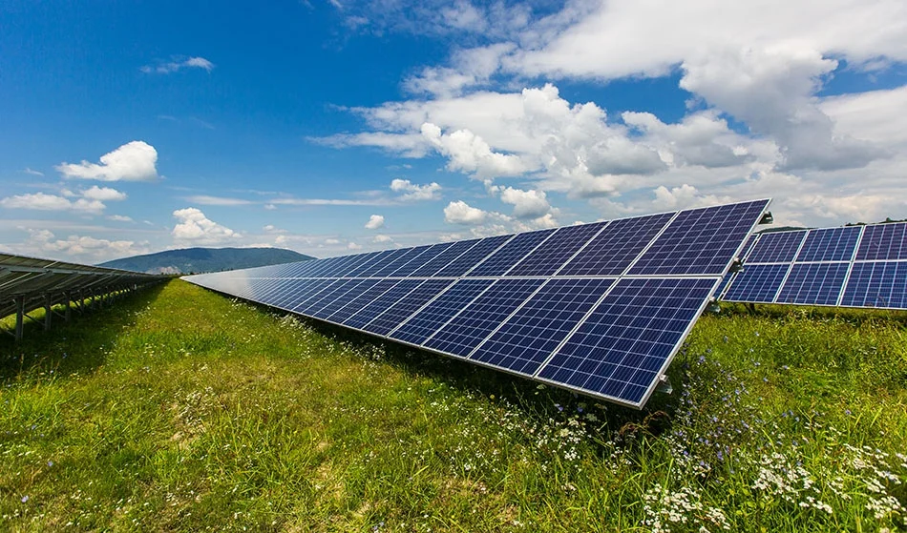
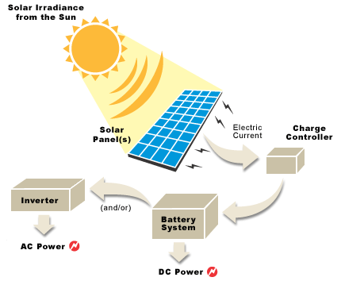
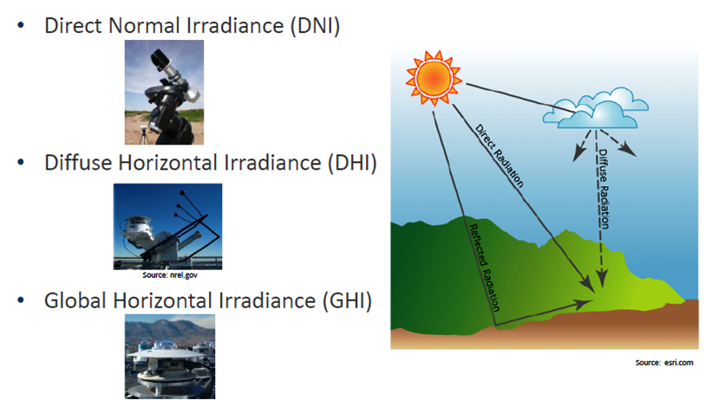
Introduction and Question to answer
Solar technologies convert sunlight into electrical energy either through photovoltaic (PV) panels
Solar produced 4.7% of U.S. electricity in 2022
What is the efficiency of different types of solar panels?
What is the relationship of location data , time data, weather data (including cloud type) and real-time solar irradiance (evaluated in DNI, DNI, GHI)?
Notes:
Introduction:
1. Solar technologies convert sunlight into electrical energy through photovoltaic (PV) panels
2. Solar produced 4.7% of U.S. electricity in 2022
3. What is the efficiency of different types of solar panels? Nowadays We have many types of solar panel materials and technology. In this project, the efficiency 10 types of solar panel materials will be studied based on real world measurement dataset: single-crystalline /ˈkrɪstəlaɪn/ silicon to multi- crystalline /ˈkrɪstəlaɪn/ silicon,from manufacturer 1 to manufacture 9
4. What is the relationship of location data (longitude and latitude), time data(y-m-d h-m-s), weather data (including cloud type) and real-time solar irradiance (evaluated in DNI, DNI, GHI)?
Solar irradiance includes three components that measured in different way. The way how the three components is defined is very technical but you can see from the image what the difference among DNI DHI GHI.

Slide 3
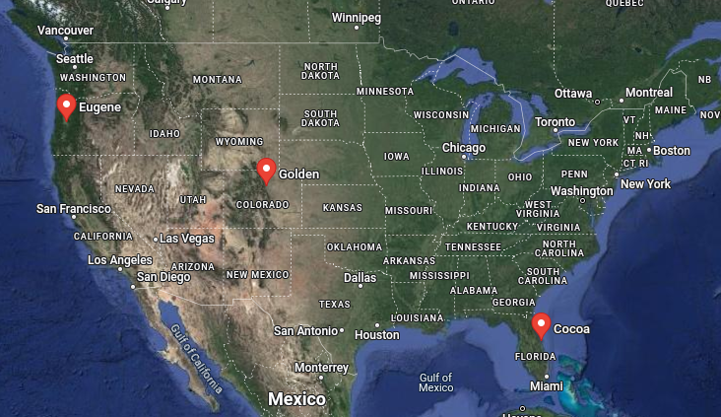
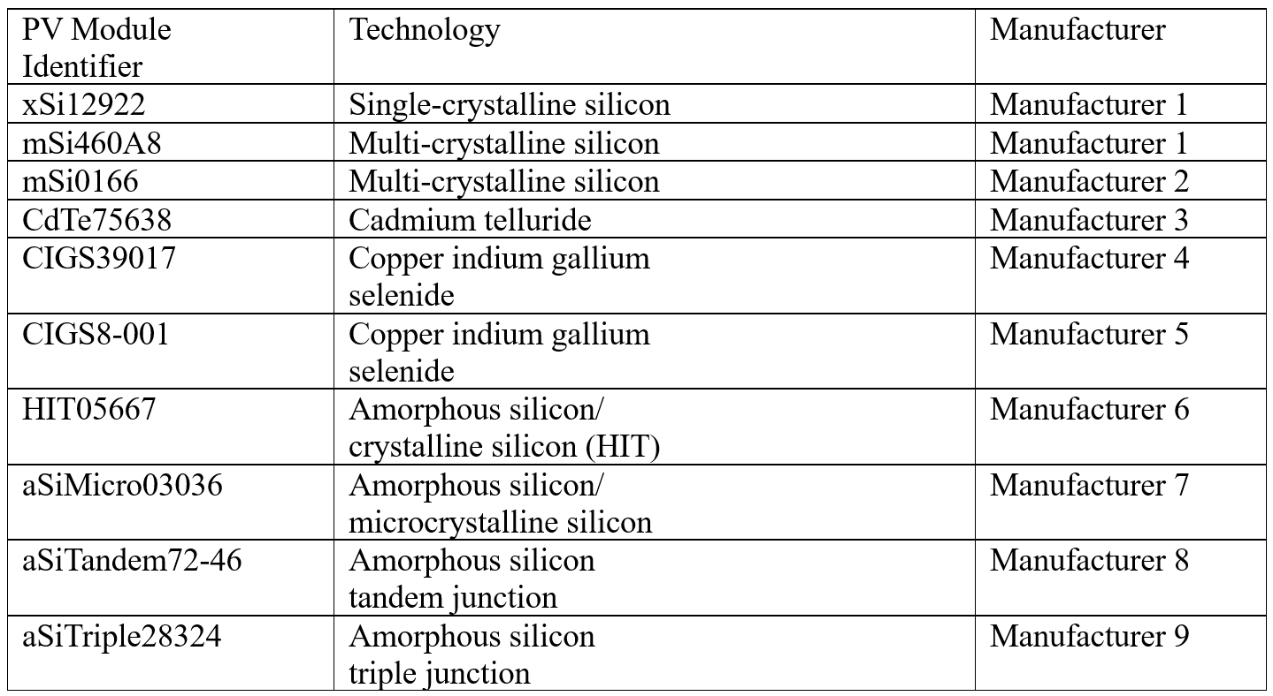
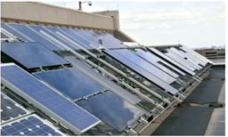
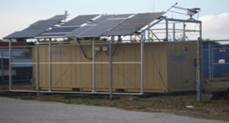
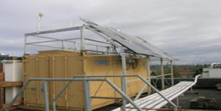
Data Collection and Cleaning
The solar panel power output data is measured and validated in a public NREL report: “User’s Manual for Data for Validating Models for PV Module Performance”.
The solar irradiance data is downloaded from the National Solar Radiation Database (NSRDB) developed by the National Renewable Energy Laboratory (NREL)
Real world dataset from 2012 to 2013 is collected from the NSRDB and NREL report.
Data cleaning
Fig. 1. PV modules and solar radiation measurement devices deployed on the Golden, Colorado(left); Cocoa, Florida(middle) and Eugene, Oregon(right) ²
Notes:
Dataset Collection and Clearning
In this study, we are using open-source databases.
The solar irradiance data is downloaded from the National Solar Radiation Database (NSRDB) developed by the National Renewable Energy Laboratory (NREL) [1].
The solar panel power output data is measured and validated
in a public NREL report: “User’s Manual for Data for Validating Models for PV
Module Performance”.
We use real world dataset from 2012 to 2013 from the NSRDB and NREL report. Including weather, location, timing, solar irradiance and solar panel power output data.
The picture of experiment PV Modules is shown in Fig. 1.
We collect data from three locations west coast /ˈjʊdʒin, mid-US, and east coast
Right hand side list ten types of solar panel technologies from 9 manufactures.
We also use data cleaning technique to clean the empty value column and exclude the unrelated parameters.

Slide 4
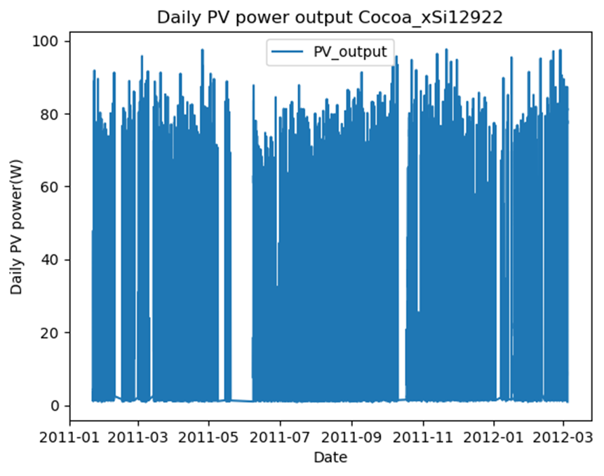
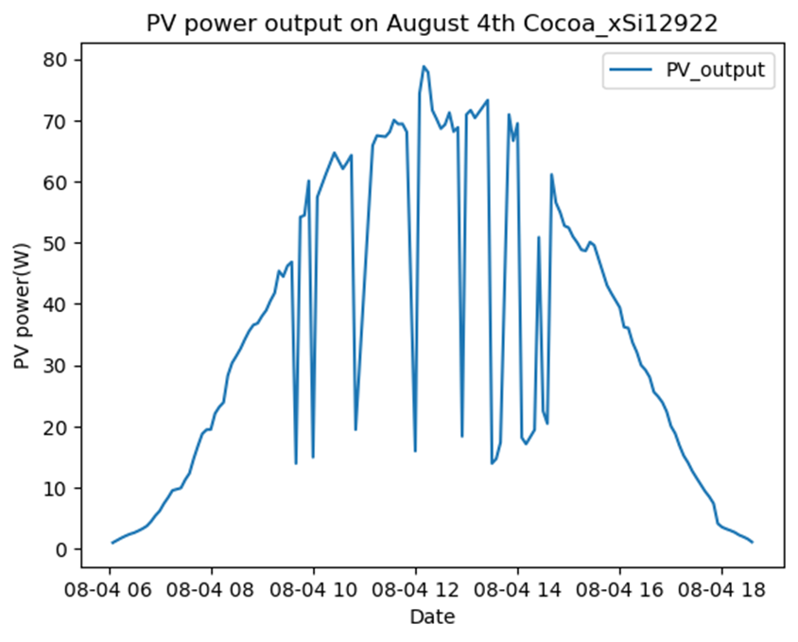
Solar power output in one year and one summer day in Cocoa, FL
Notes:
Here you can see the solar power outpout in one year and one typical summer day in Florida.
1. From the measurement, the peak solar output is usually at noon time from 12-2pm
2. Actually from the yearly solar power output measurement data, you can find that solar panel can also generate lots of solar power in florida winter time. That’s why make florida is good place to deploy solar project can generate good solar power all year long.
3. Solar energy is super fluctuate which is a big challenge to the power system. That’s why our power system engineer need to get prepared for challenging renewable energy brought to us

Slide 5
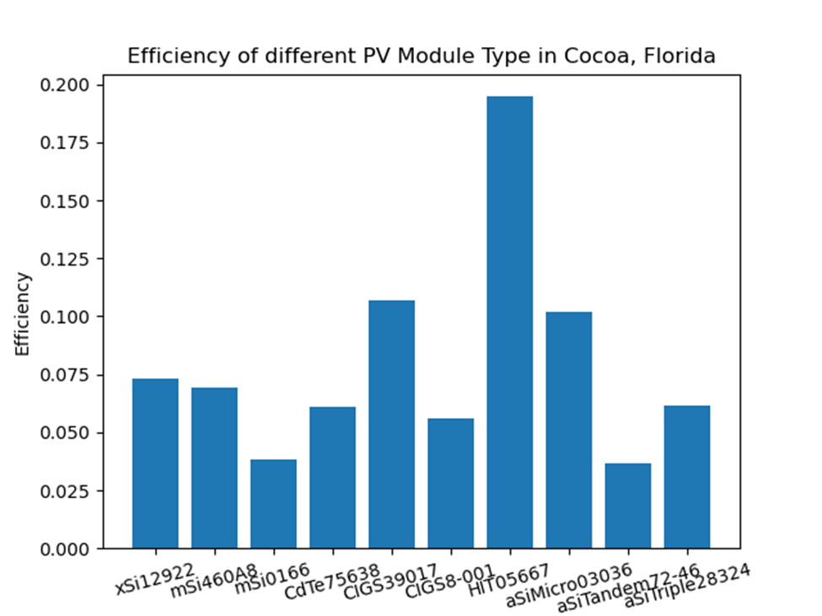
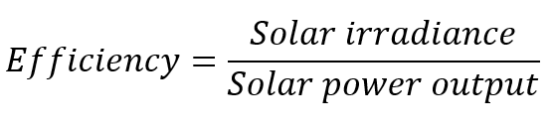
Solar PV module type and efficiency
Based on the real world measurements of PV module in Cocoa Florida from 2012 to 2013, we have the following conclusion:
PV module mSi0166(Multi-crystalline silicon) has the worst efficiency 3.82%
PV module HIT05667 (Amorphous silicon/crystalline silicon (HIT)) has the best efficiency of 19.47%.
Manufacture 1’s mSi460A8 VS manufacture 2’s mSi0166.
Notes:
Based on the real world measurements of PV module in Cocoa Florida from 2012 to 2013, we have the following conclusion:
PV module mSi0166(Multi-crystalline silicon) has the worst efficiency 3.82%
PV module HIT05667 (Amorphous silicon/crystalline silicon (HIT)) has the best efficiency of 19.47%.
Even using the same technology Multi-crystalline silicon to manufacture PV module, manufacture 1’s mSi460A8 has a much better efficiency than manufacture 2’s mSi0166.

Slide 6
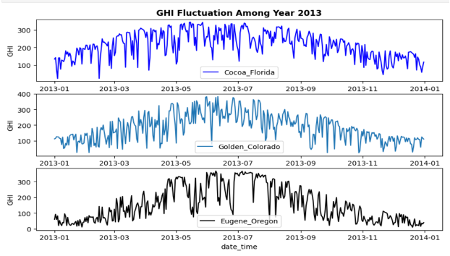
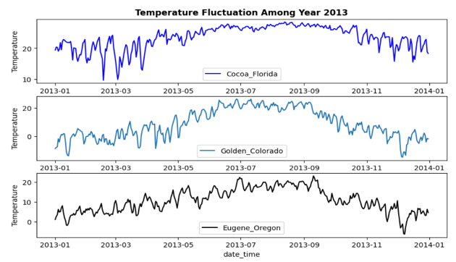
Question One:
How does GHI and Temperature change during the entire year 2013?
Notes:
The start point of my analysis is to conduct an observation about the pattern of GHI and Temperature in 2013, thereby evaluating possible similarity and correlationship. The first question I establish is – To answer the first question, we choose time series plotting.
Among entire year, highest GHI happened around 2013-05 to 2013-08 ans highest Temperature happened around 2013-06 to 2013-08
Trends of GHI Fluctuation over 2013 shows similarity as temperature Fluctuation in our plotting, and to To get further confirmation of our discovery, analysis about GHI and temperature in 24 hours (one specific day) is established.

Slide 7
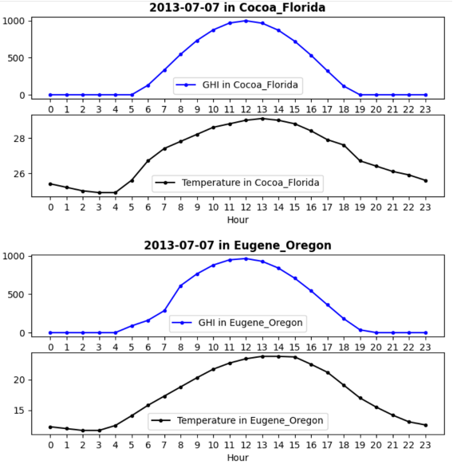
Question Two:
How does GHI and Temperature change on one specific day (2023-07-07)?
Conclusion:
There exist positive correlation between temperature and GHI
Notes:
In the next step, We want to know How –
In here, The day (07-07) was chosen to show greater numerical fluctuations. because of the highest GHI among the entire year, In addition, Cocoa Florida and Eugene Oregon are chosen as locations for the sake of controlling cloud type variables -- cloud type of selected city in 07-07 kept static at 0 and It will provide support to reduce bias. We can see both figure in cocoa Florida AND eugene oregon shows similarity when consider about trend of GHI and trend of temperature. We can conclude from both yearlyand daily time series data plotting that,There exist positive correlation between temperature and GHI

Slide 8
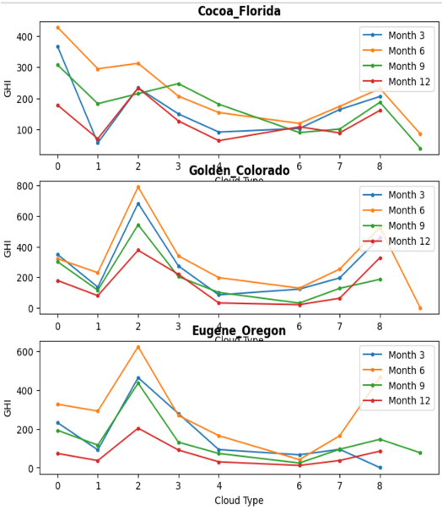
Question Three:
Consider about Cloud Type and GHI,
which Cloud Types shows highest GHI and which shows lowest?
Summarization from the left figure:
4 lines representing different season own similar trend and prove that there exist correlation between Cloud Type and GHI
Highest GHI: Cloud Type 2 -- Fog
Cloud Type 8 -- Overlapping
Lowest GHI: Cloud Type 6 -- Opaque Ice
Notes:
Next exploration will be the relationship between Cloud Type and GHI
And we conduct the third question
To reduce the bias coming from temperature's inference in our analysis. We select 4 different months: 3 (Spring),6(Summer),9(Fall),12(Winter) .The major idea is to plot the GHI over cloud type in 4 different seasons for 3 different location,to ensure all temperature levels are included. From the plotting, Even the line represent Code Winter shows high GHI on Cloud type 2 and 8. And Even the line represent Hot Summer shows low GHI on Cloud Type 6

Slide 9
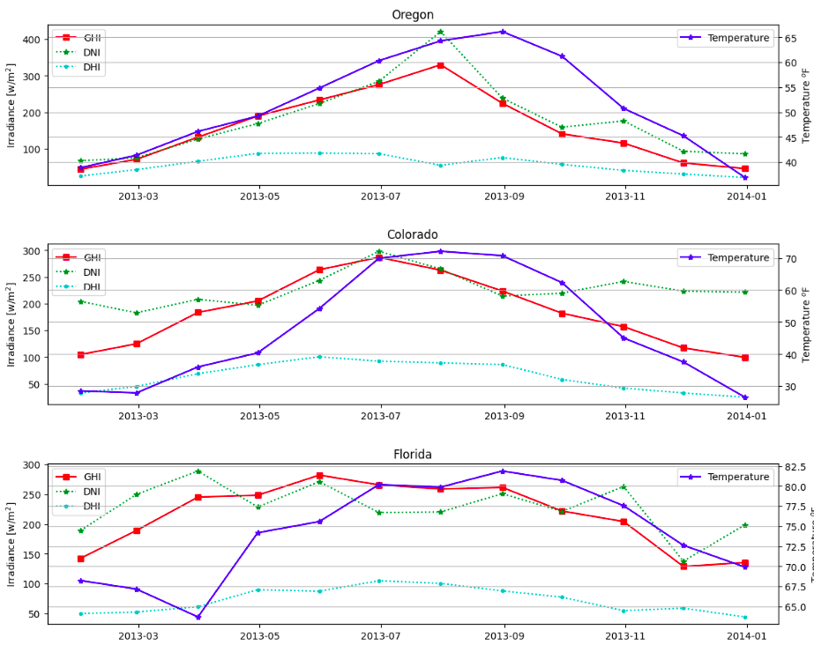
Solar Irradiance and Temperature Monthly Analysis
DNI, Direct Normal Irradiance It’s the sunlight that comes directly from the sun, without bouncing off anything else.
DHI, Direct Diffuse Horizontal Irradiance The sunlight that reaches the ground after it has been scattered by the atmosphere.
GHI, Global Horizontal Irradiance All the sunlight that hits a flat surface from every direction, not just directly from the sun.
Temperature Solar panels perform better around 25 degrees Celsius / 77 degrees Fahrenheit.
Notes:
Today, we’re going to discuss the factors that influence the choice of a solar panel installation site. These include sunlight exposure, local climate conditions, roof orientation, and surrounding shading. All of these factors can significantly impact the performance of a solar panel.
Our data include
data collected from Oregon, Colorado, and Florida.
Four key variables: DNI, DHI, and GHI
For the year 2013
We’ve created a chart that illustrates these four variables using their monthly averages. This gives us an idea of how these variables change throughout the year.
At a quick glance, you can see that all three locations share similar patterns. For instance, GHI stays above 150 from May to November in all locations except for Florida, where its GHI values stay above 150 all year round.
So all three locations present good environmental conditions for developing solar energy, especially during the summer months when sunlight exposure is abundant.

Slide 10
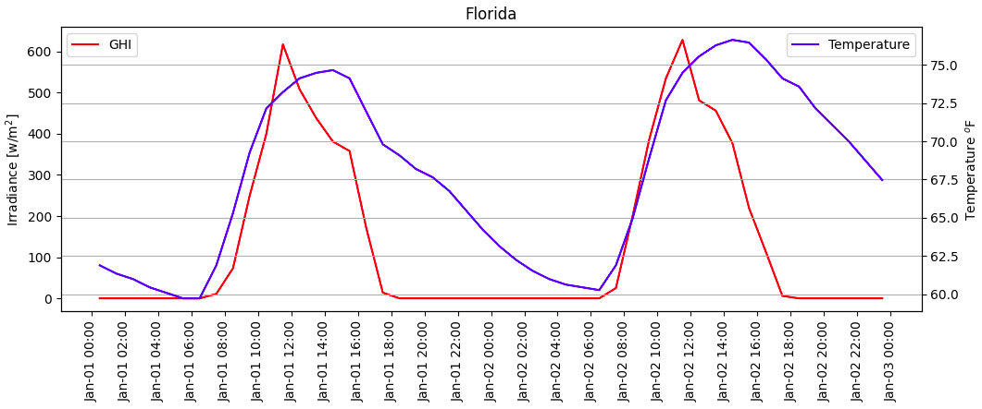
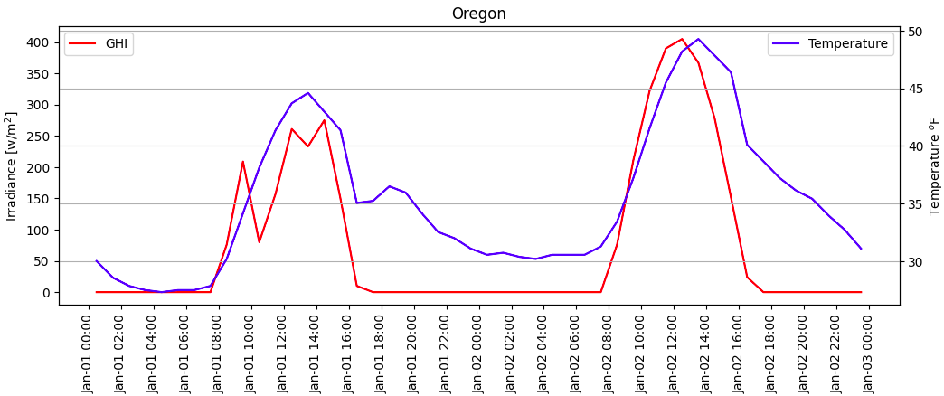
Solar Irradiance and Temperature Winter Analysis
Florida provides an average GHI of 280 during 9 hours of operating time (8 AM - 5 PM) Florida’s primary electricity source is Natural gas (74%) with Solar around 3.7%. Floria is also ranked 3rd in solar capacity in the United States in 2023.
Oregon provides an average GHI of 200 during 7 hours of operating time (9 AM - 4 PM) Oregon’s primary electricity source is Hydro (39%) with Solar less than 2%.
Notes:
Let’s now turn our attention to the winter months, when sunlight exposure is reduced. We’ll take a closer look at Florida’s data during this time to understand how its Global Horizontal Irradiance (GHI) and temperature change from January 1st to 2nd. As you can see, the GHI stays above 100 from 8 AM to 5 PM, coinciding with the time of sunrise and sunset. This means that Florida provides a healthy GHI with good temperature for 9 hours.
Now, if we run the same analysis for Oregon during the same time, we see a very different result. Not only is the average GHI about half compared to Florida, but its effective sunlight exposure is only about 7 hours, from 9 AM to 4 PM.
As a result of these differences, Oregon’s primary electricity source is Hydro, accounting for 39% of its total, with Solar contributing less than 2%. In contrast, Florida’s primary electricity source is Natural Gas, making up 74% of its total, with Solar around 3.7%. Furthermore, Florida is ranked 3rd in solar capacity in the United States in 2023.
This comparison clearly illustrates the impact of geographical and climatic factors on the effectiveness of solar energy generation.

